Slide 1

TRANSGENDER DAY OF VISIBILITY
Out and Proud
March 31, 2022

Slide 2
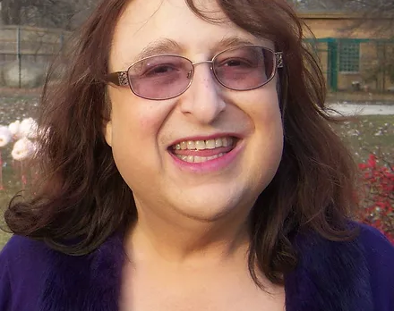
Rachel Crandall-Crocker
1958-
she/her
Upset that trans individuals only had a somber holiday to observe, Transgender Day of Remembrance, she founded Transgender Day of Visibility in 2009 to celebrate the diversity and vitality of transgender folks worldwide
@rachelcrandall

Slide 3
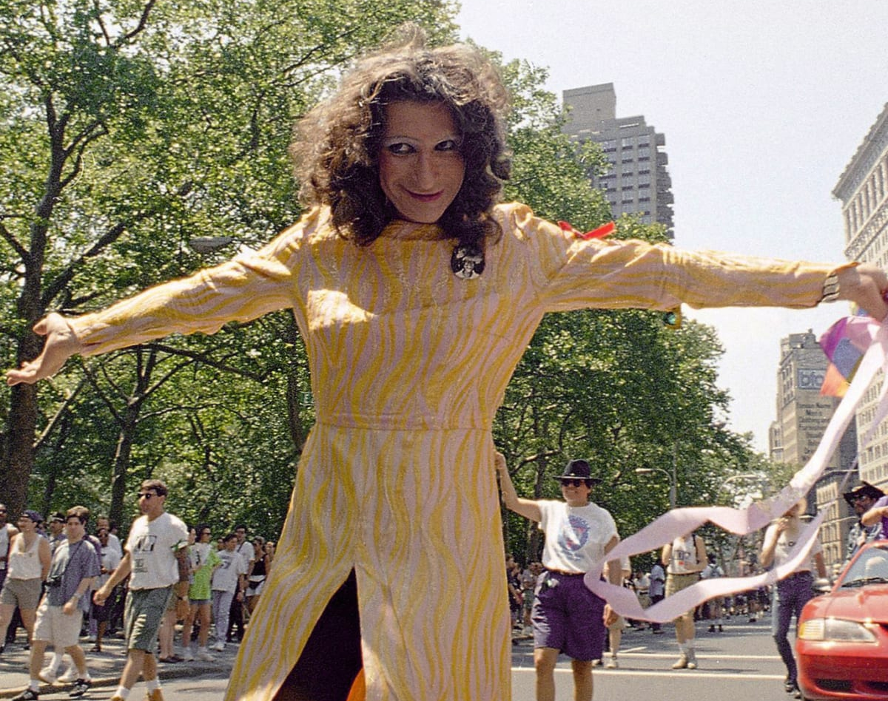
Sylvia Rivera
1951-2002
she/her
Community worker, drag queen, and transgender liberation activist, who participated in actions with the Gay Liberation Front and STAR, fighting for trans individuals to have a place in the movement

Slide 4
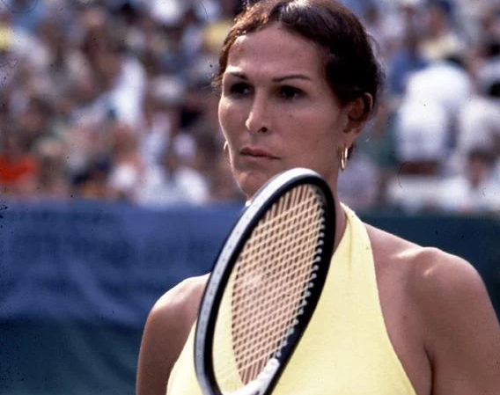
Renée
Richards
1934 -
she/her
Former tennis player who fought to compete as a woman in the US Open and won, marking a landmark court case for transgender rights in sports

Slide 5
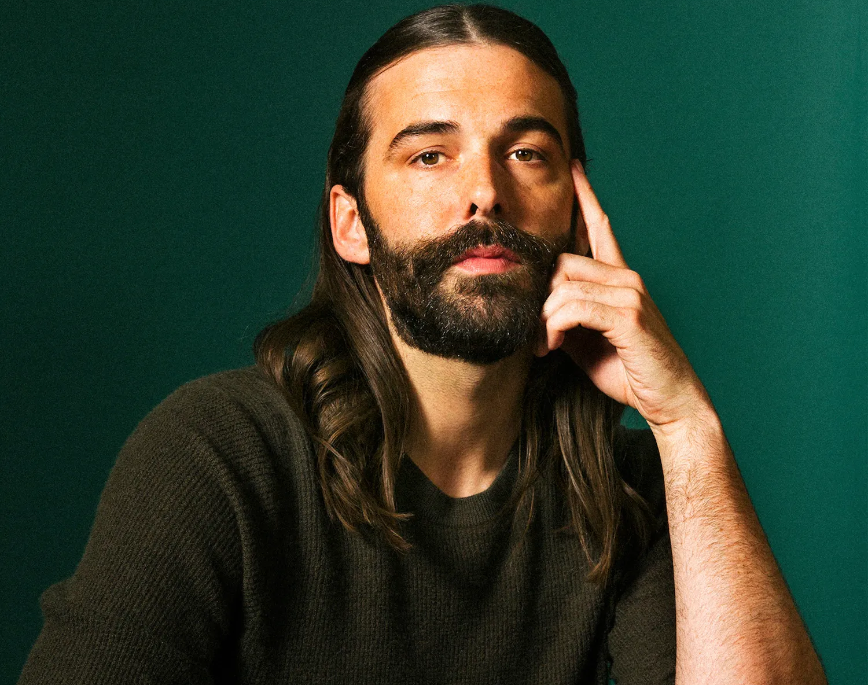
Jonathan Van Ness
1987-
they/he/she
An HIV+ nonbinary truth teller, comedian, hair stylist, and tv personality
@jvn

Slide 6
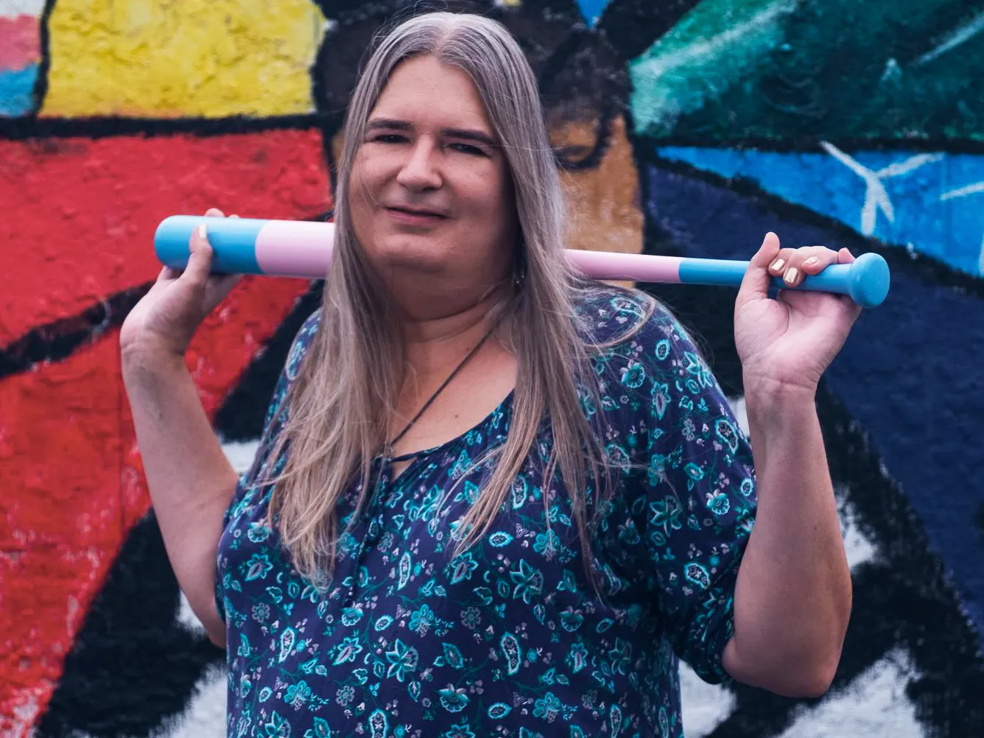
Gwendolyn Ann Smith
1967 -
she/her
Founded Transgender Day of Remembrance in 1999, a day to remember people who have been killed due to anti-trans violence, which happens every year on November 20th
@gwenners

Slide 7
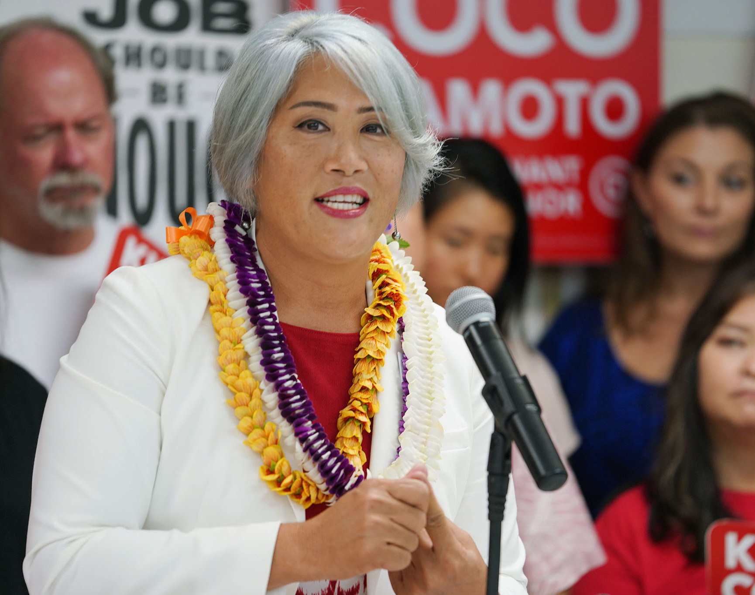
Kim Coco Iwamoto
1968-
she/her
Hawaiian politician and first openly transgender elected official in the United States
@votekimcoco

Slide 8
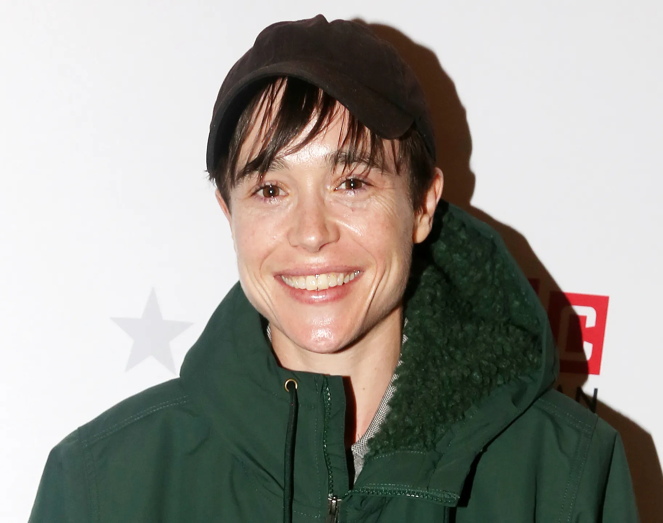
Elliot Page
1987-
he/him/they/them
Award-winning transgender and nonbinary Canadian actor, producer, and activist, and was the first openly transgender person on the cover on TIME Magazine
@elliotpage

Slide 9
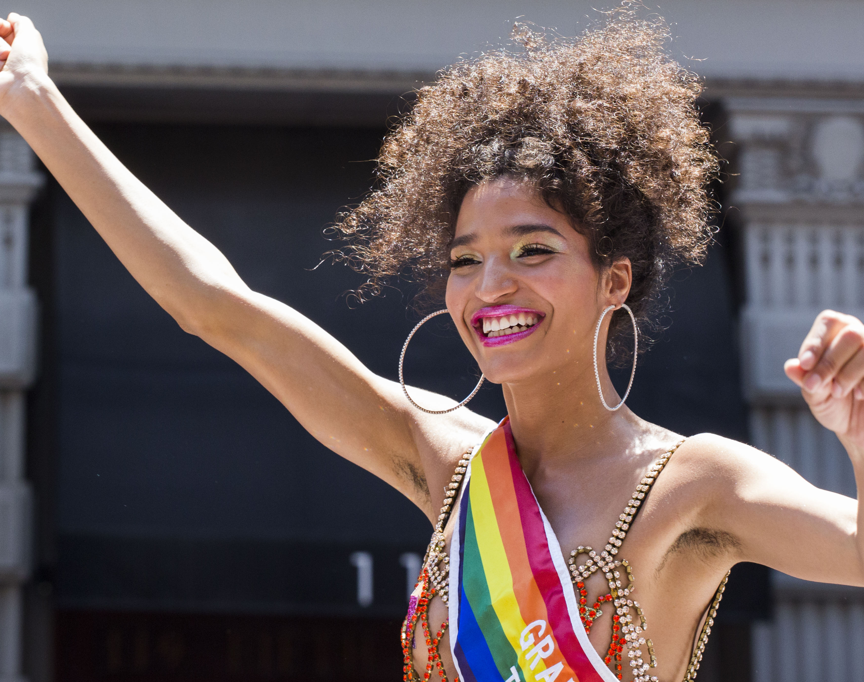
Indya Moore
1995-
they/them/she/her
Fearless transgender and nonbinary actor, model, and activist who shares their journey through generational trauma and identity to support and inspire others
@indyamoore

Slide 10
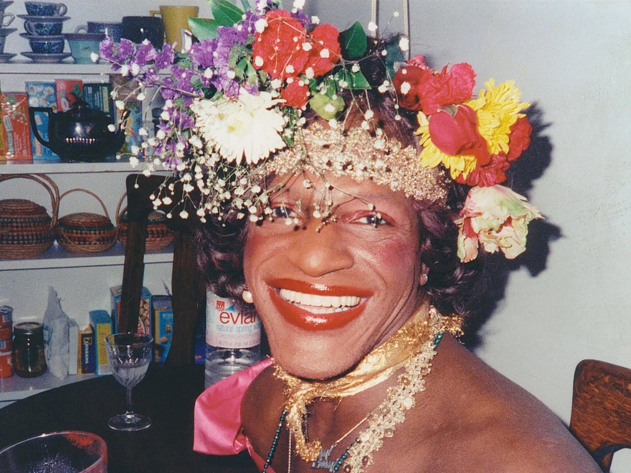
Marsha P. Johnson
1945-1992
she/her
Trailblazing gay and trans liberation activist and self-identified drag queen, known for her outspokenness and advocacy for transgender rights during the time of the Stonewall Uprising in 1969

Slide 11
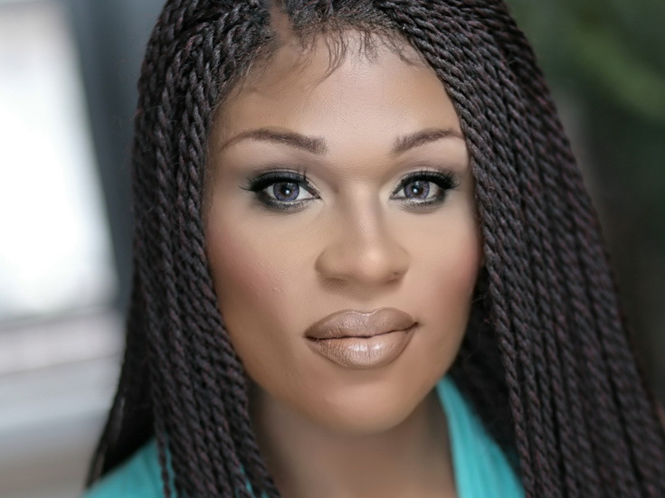
Peppermint
1979-
she/her
Actress, drag queen, and activist from New York City, known for her appearances on Ru Paul’s Drag Race and in play Head Over Heels, making her the first out trans woman to originate a lead role on Broadway
@peppermint 247

Slide 12
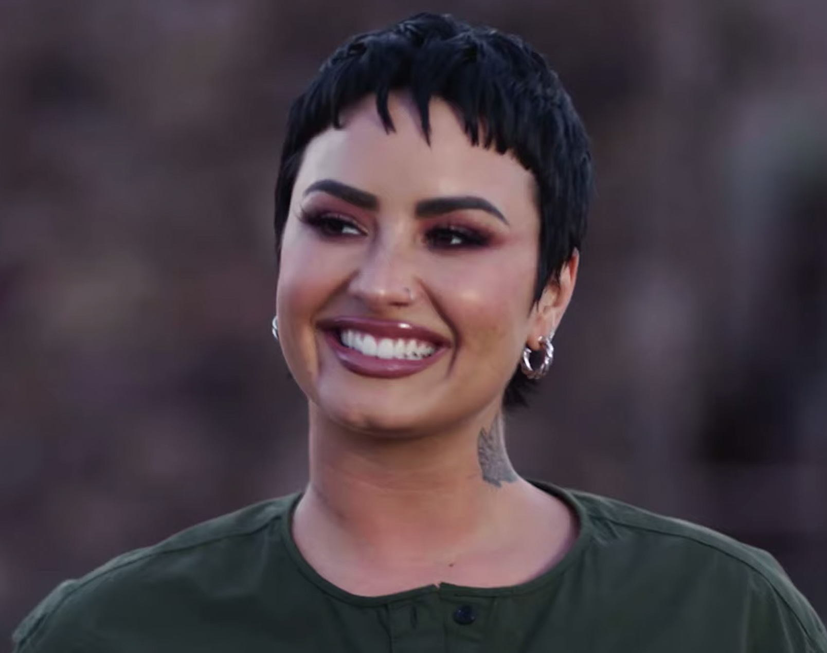
Demi Lovato
1992-
they/them
Nonbinary American singer, songwriter, and actor, known for their activist work for LGBTQ+ rights and against bullying
@ddlovato

Slide 13
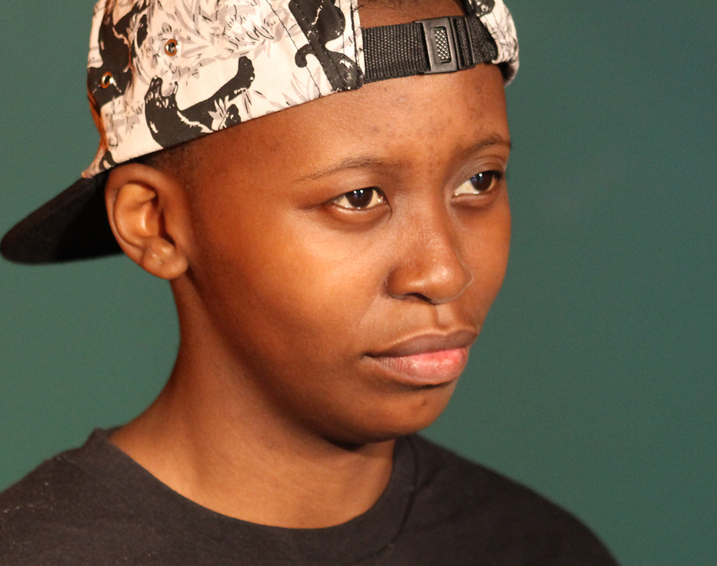
Lee Mokobe
1995-
he/him/they/them
Transqueer South African slam poet, whose award-winning writing and performance discuss social justice, Blackness, and immigration
@leemokobe

Slide 14
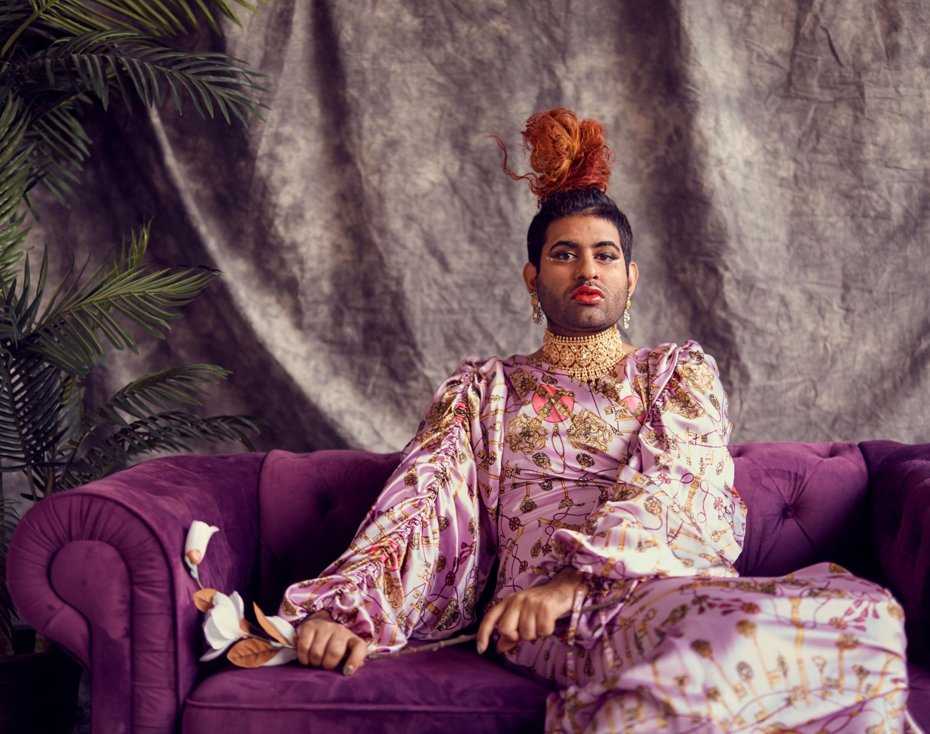
Alok Vaid-Menon
1991-
they/them
Gender non-conforming author, performer, artist, and culture shifter, and the creator of #DeGenderFashion, a movement to degender the fashion and beauty industries
@alokvmenon

Slide 15
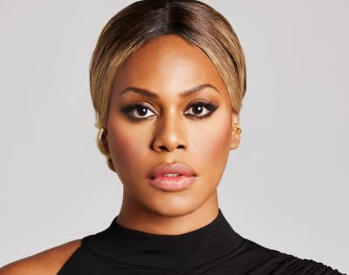
Laverne Cox
1972-
she/her
American actress, director, and LGBTQ rights advocate committed to increasing Black and LGBTQ representation in film and media and fighting against identity-based violence
@lavernecox

Slide 16
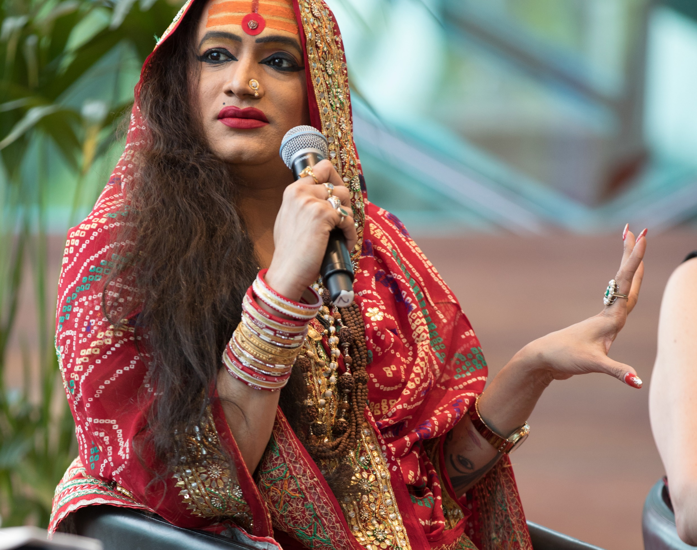
Laxmi Narayan Tripathi
1979-
she/her
Transgender and Hijra rights activist, Bollywood actress, dancer, choreographer, and motivational speaker from Mumbai, India
@laxminarayan_tripathi

Slide 17
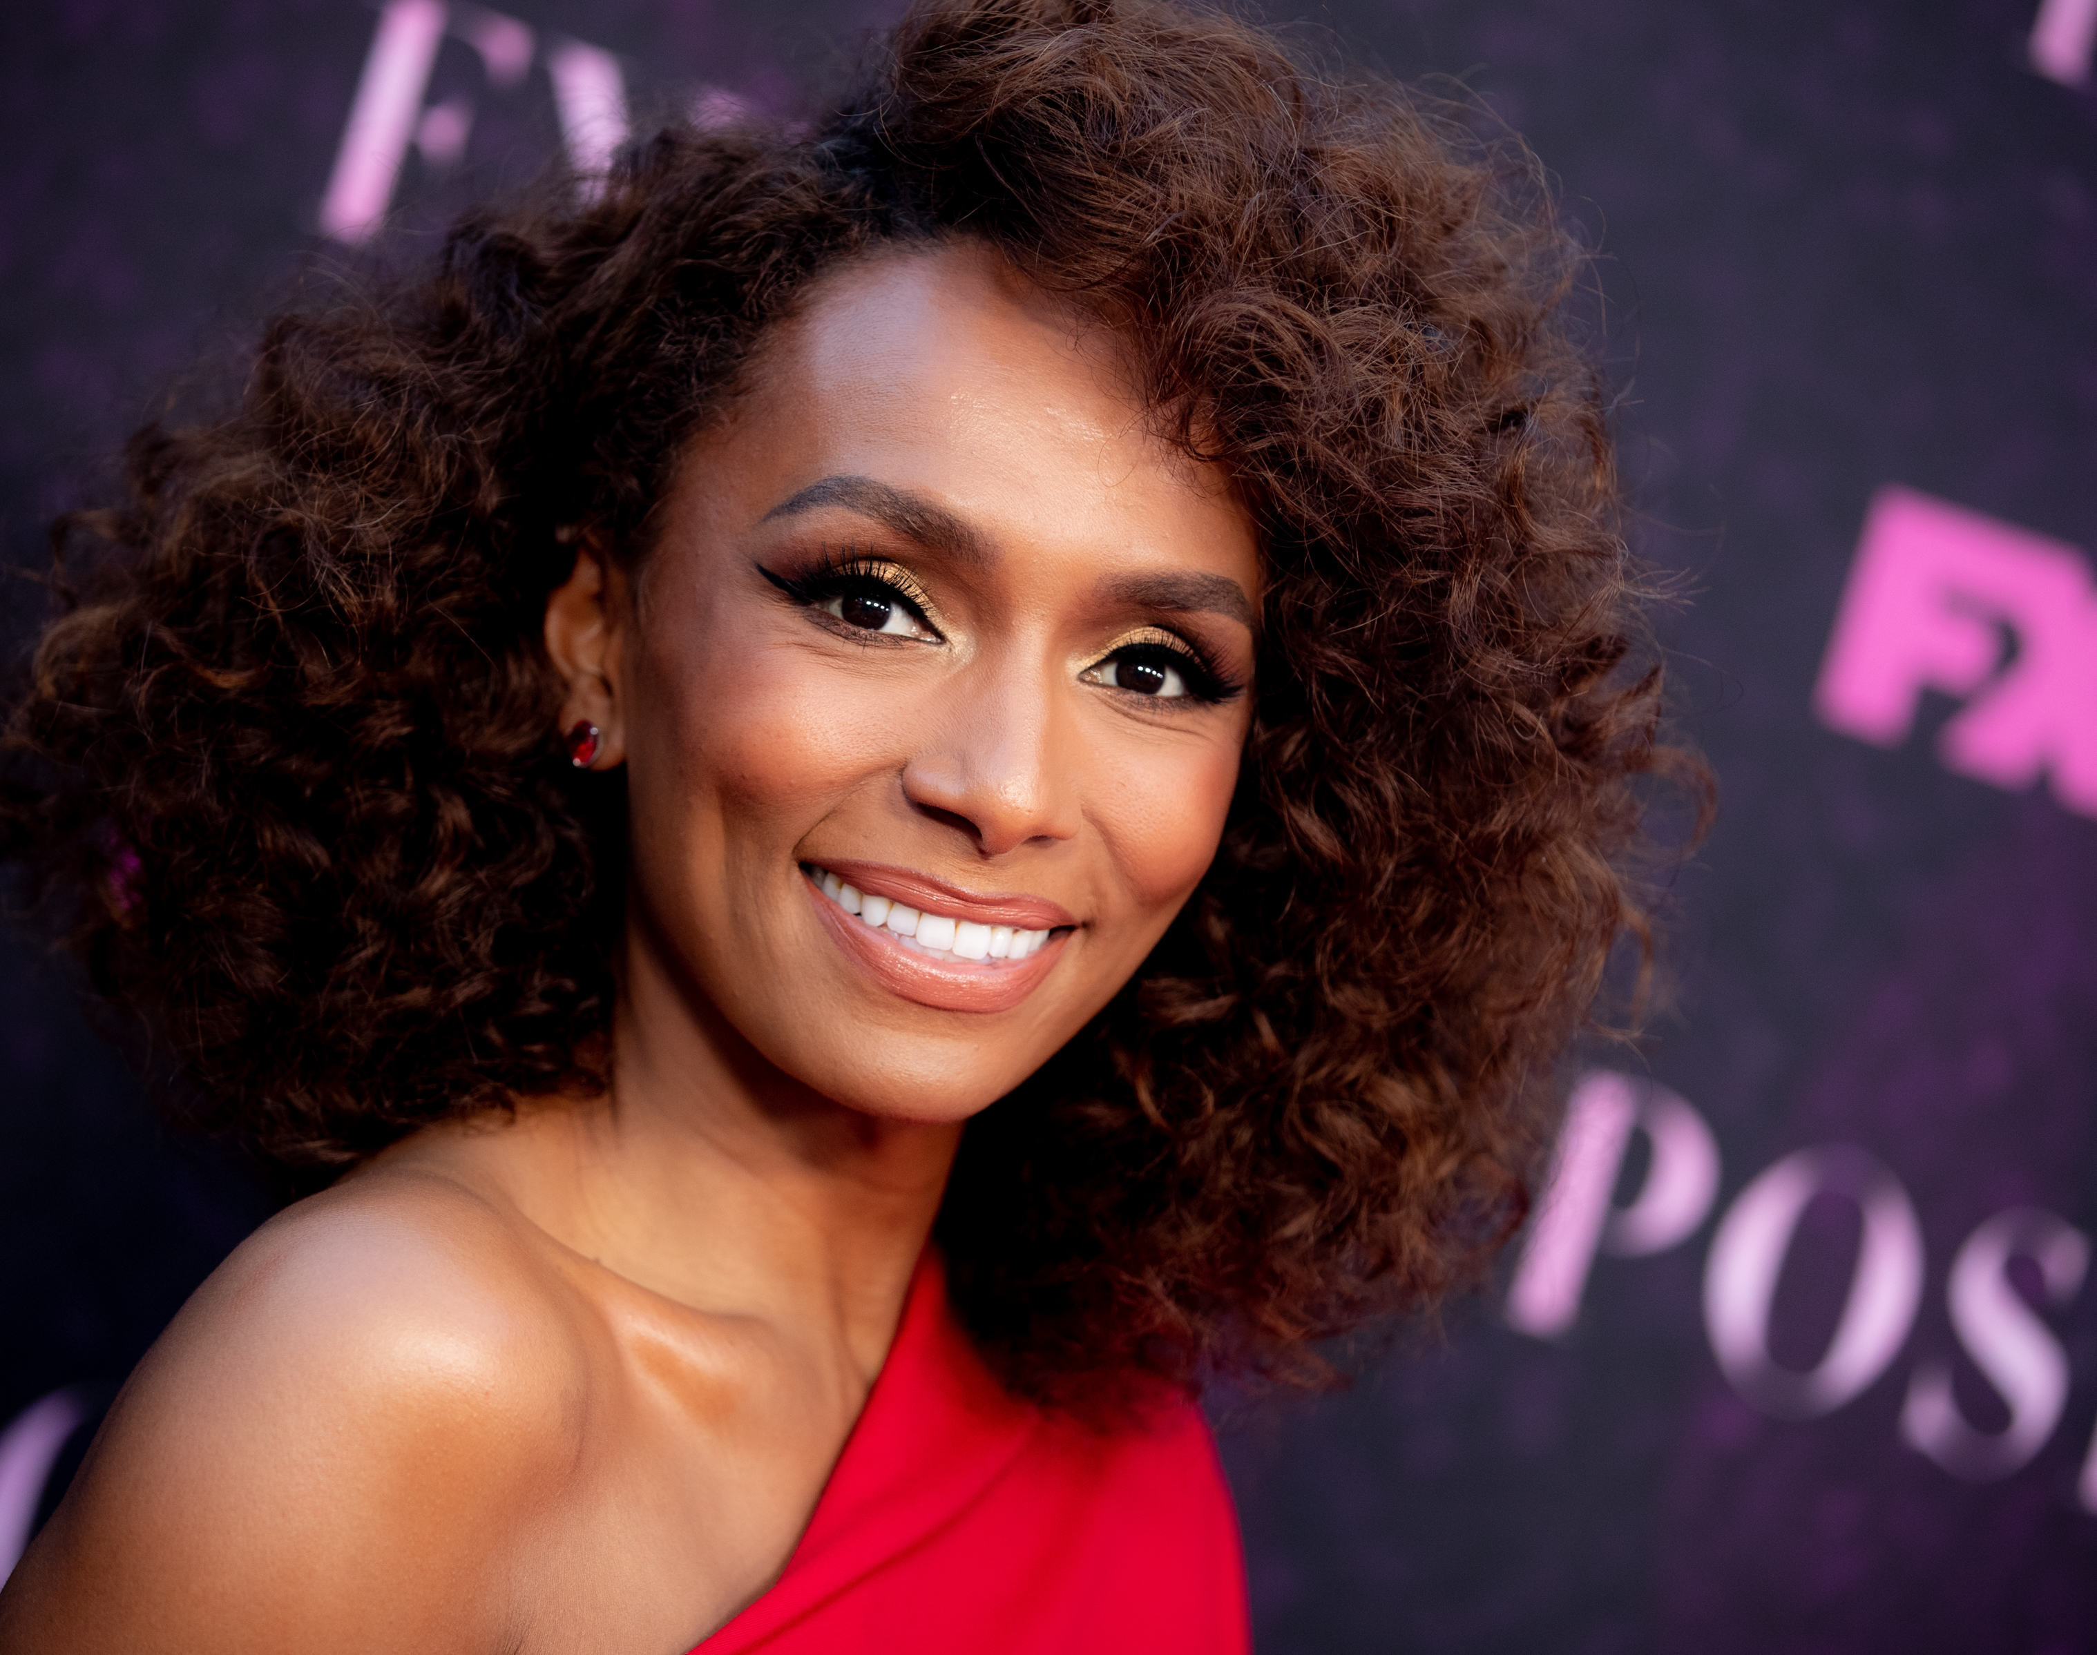
Janet Mock
1983-
she/her
Emmy-nominated writer and producer of POSE, and first transgender person to sign a production contract with a major studio
One of TIME’s 100 most influential people and recipient of the Sylvia Rivera Activist Award
@janetmock

